Slide 1
PROJECTION

Slide 2
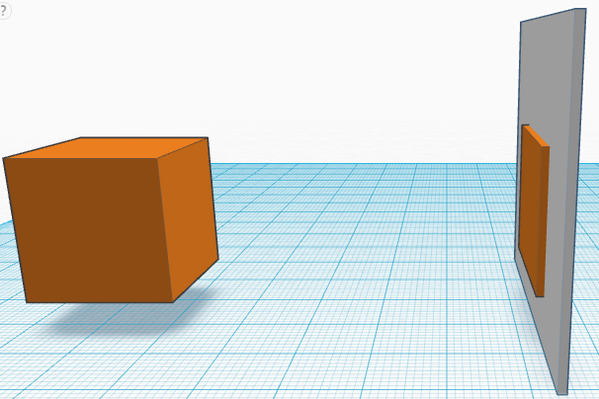
Parallel projection
All projecting rays are parallel
We view object from infinite distance

Slide 3
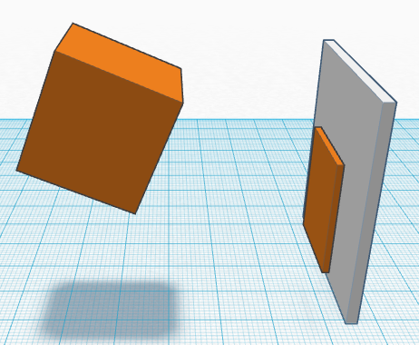
Orthographic projection
All projecting rays are perpendicular to projecting plane
Oblique projection
The projecting plane is at an angle with projecting rays

Slide 4
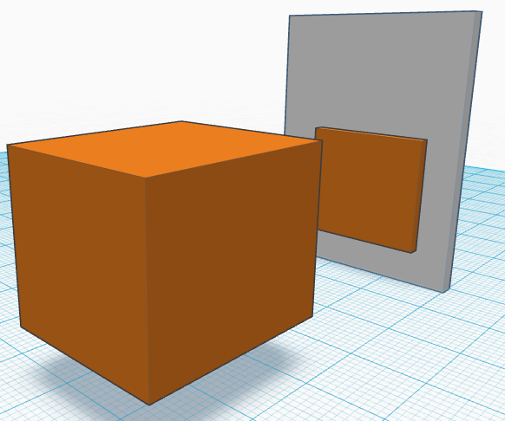
Perspective projection
All projecting rays are intersecting at finite distance

Slide 5
Orthographic projection on XY plane
P(x ,y, z)
P’(x ,y, 0)
Y
X
Z

Slide 6
Orthographic projection on an arbitrary plane
u
(l, m, n)
(x₀ , y₀, z₀)
Y
P(x ,y, z)
P’(x’ ,y’, z’)
X
Z

Slide 7
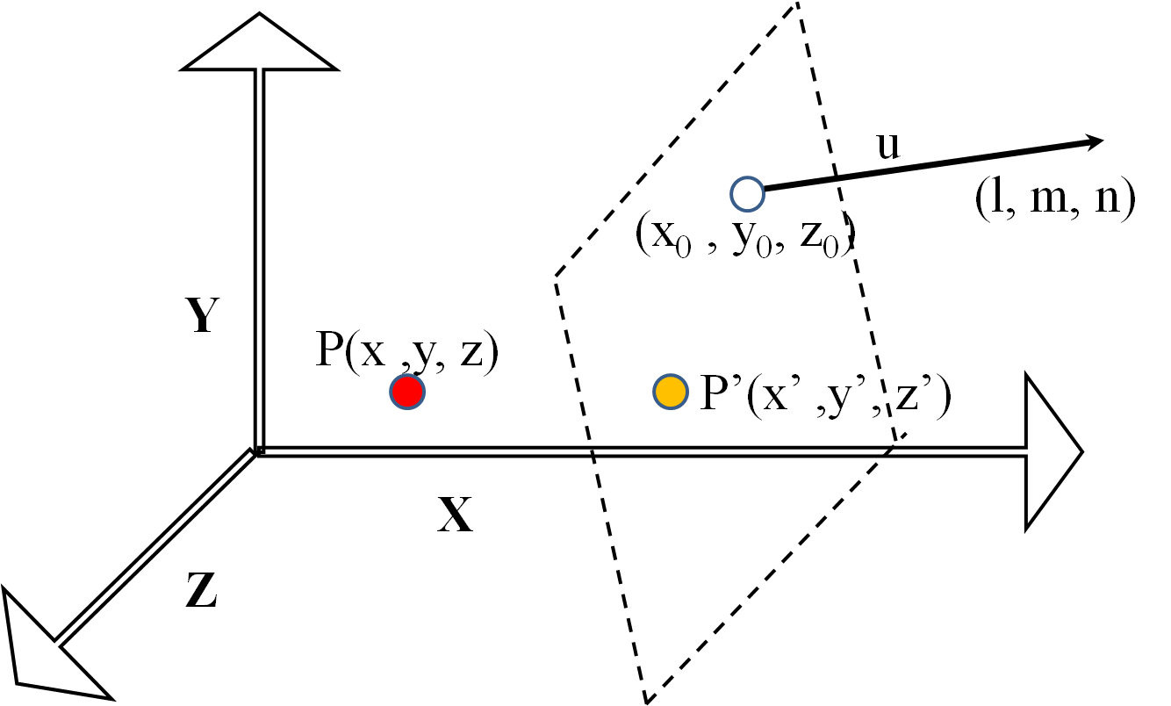
1.Transalte (x₀ , y₀, z₀) s.t. it
becomes new origin
2. Rotate the plane s.t.
u(l, m, n) coincides with Z-axis or the plane become XY plane
3. Project point as
‘Orthographic projection on
XY plane’
4. Reverse of ‘2’
5. Reverse of ‘1’.

Slide 8
General parallel projection on XY plane
P’(x’ ,y’, z’)
Y
(l, m, n)
X
Z
P(x ,y, z)

Slide 9
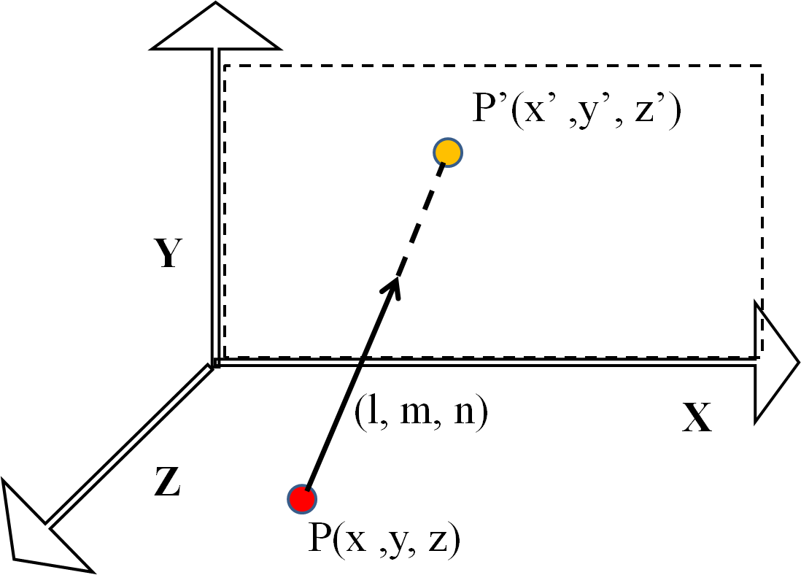
Equation of the projecting line
Equation of XY plane
Intersection point

Slide 10
Perspective projection when eye is on Z-axis
P(x ,y, z)
P’(x’ ,y’, z’)
Y
y
y’
Z
B
O
d
x’
x
E(0 ,0, d)
C
A
X

Slide 11
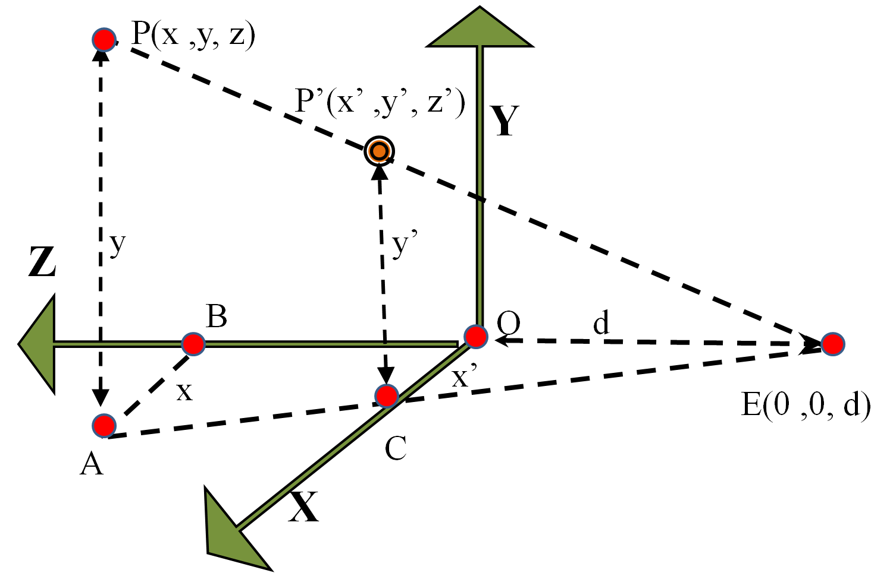

Slide 12
Perspective projection on any plane when eye is at origin
(x₀ , y₀, z₀)
u
(l, m, n)
v
Y
P(x ,y, z)
P’(x’ ,y’, z’)
E
X
Z

Slide 13
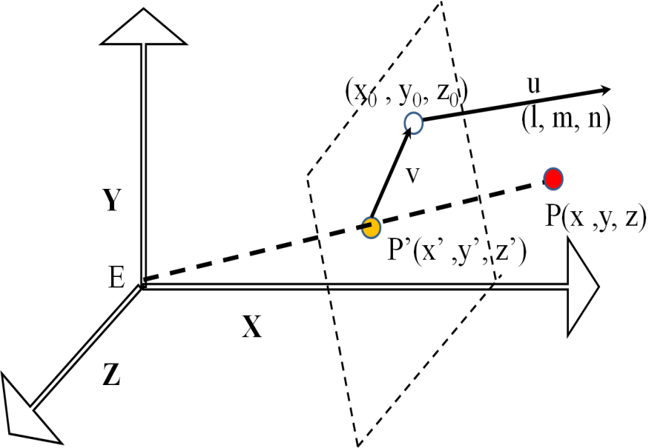
v be a vector on the plane and passing through (x₀ , y₀, z₀)
Equation of the plane
v is on the plane
(l, m, n) is perpendicular to the plane
P(x₂ ,y₂, z₂)
(x ,y, z)
P’(x’ ,y’, z’)
E(x₁ ,y₁, z₁)
(0 ,0, 0)
Equation of the st. line

Slide 14
Solve for t

Slide 15
General perspective projection
E(a ,b, c)
Y
P(x ,y, z)
P’(x’ ,y’, z’)
X
Z

Slide 16
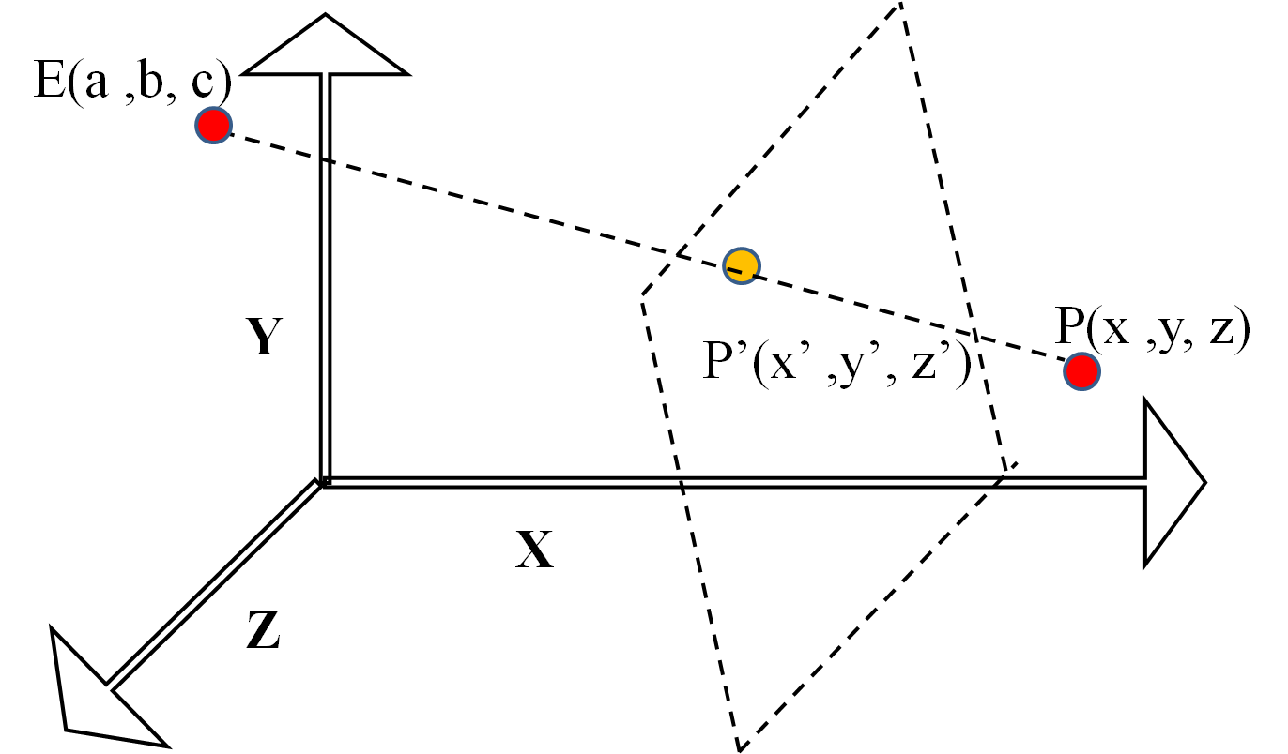
1.Translate (-a,-b,-c) s.t E becomes origin
2.Use ‘Perspective projection on any
plane when eye is at origin’
3.Reverse of ‘ 1’

Slide 17
END OF CHAPTER

